Slide 1
November PTA Meeting
November 16, 2016
Welcome from PTA Presidents
Updates from Ms. Rosa and Ms. Yvette
Upcoming Events
Budget report from the PTA Treasurer
Annual Appeal
Mini Grant Report – One Book, One Page
Foley Christmas Tree Fundraiser

Slide 2
Update from Parent Coordinator
Food Drive: November 9 to November 21, food pantry of St. Thomas Aquinas Church Park Slope.
Second Cup of Coffee
UNICEF: Big thank you for all who participated.
Middle School Parent Panel: Tuesday, November 29, 8:30am cafeteria and thank you for those who attended the Middle School Meet & Greet this past Tuesday, November 15. Middle School applications are due back on December 1st.
Parent Room – Room 101: Computers are set up for parents who do not have access to a computer.

Slide 3
Introducing Interim Acting Assistant Principal
Rosa Perez-Leonetti

Slide 4
Events in November
Book Fair – Happening now! Literacy and community building.
We are working with a new vendor this year. The PTA keeps 35% of profits. Today is the second shopping day for students at ICT and the shopping day for students at ASD. If your child has placed a book or books on hold, all purchases must be completed by tomorrow 10:30 am.
Events in December!
Winterfest – Wednesday, December 21st. School-wide holiday celebration. Performances by students. Bake sale.
No PTA Meeting!!!!

Slide 5
PS 372 Annual Appeal
The Children’s School Annual Appeal is the year-long fundraising campaign for the PTA of PS 372. It is one of the largest sources of funds for the PTA, roughly 1/3rd of our operating budget, and has the least cost overhead of all of our fundraising initiatives. You direct giving contribution stretches farther when you contribute to the appeal.
How Much Should I Give?
To maintain our current programs, we request a donation of $180 per child ($1 per day.) Any amount, no matter how large or small, would be greatly appreciated!
Our goal is to achieve 100% participation from our families.
Donations to the Annual Appeal are 100% tax deductible. Employer matching grants are welcome. Expect to see the appeal letter later this week. There will be a contribution form and envelope attached. Contributions can also be made online.

Slide 6
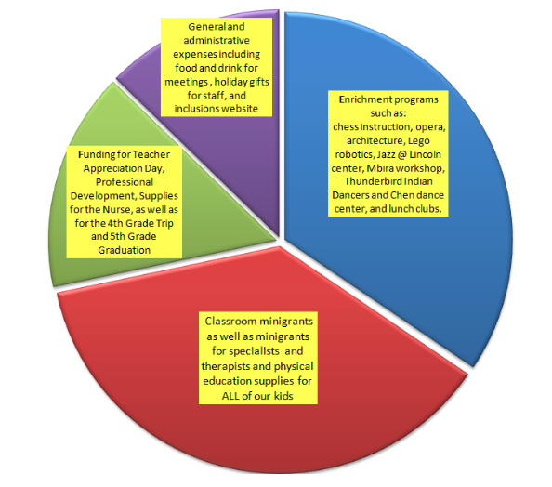
How Does the PTA Spend Funds Raised?
Mini grants for classroom and specialist teachers.
Physical education supplies for all of our kids
Enrichment programs – such as chess instruction, opera, architecture, Lego robotics, Jazz @ Lincoln center, Mbira workshop, Thunderbird Indian Dancers and Chen dance center, and lunch clubs.
Community Building initiatives – such as the New Family Picnic, Roots & Community, and Staff Appreciation Luncheon.
Sponsorships for children –4th grade Philly trip, and 5th grade graduation.

Slide 7
Mini Grant Report
One Book, One Page: Monthly read-aloud in classrooms.
PTA grant of $3000 to buy books.

Slide 8
Foley Firs Christmas Tree Fundraiser

